Slide 1

Speech recognition
Using PYTHON

Slide 2

BANGALORE INSTITUTE OF TECHNOLOGY K.R. Road, V.V. Puram, Bangalore-560 004
DEPARTMENT OF COMPUTER SCIENCE & ENGINEERING
APPLICATION DEVELOPMENT USING PYTHON (18CS55)
“SPEECH RECOGNITION USING PYTHON”
Submitted By
A M DARSHAN 1BI19CS001
ABHISHEK K 1BI19CS006
ADITHYA D S 1BI19CS008
CHIRANTH J S 1BI19CS045
for the academic year 2021-22

Slide 3
INTRODUCTION
Speech is the most common means of communication around the world. Most of the population in the world relies on speech to communicate with each other. Suppose we are building a model and instead of a written approach we want our system to respond to speech, it becomes fairly difficult and requires a lot of data to be processed. A speech recognition system overcomes this barrier by translating speech to text.

Slide 4
AGENDA
How Speech Recognition Works?
Speech Recognition Module In Python?
Taking Input From Microphones
Use Case

Slide 5
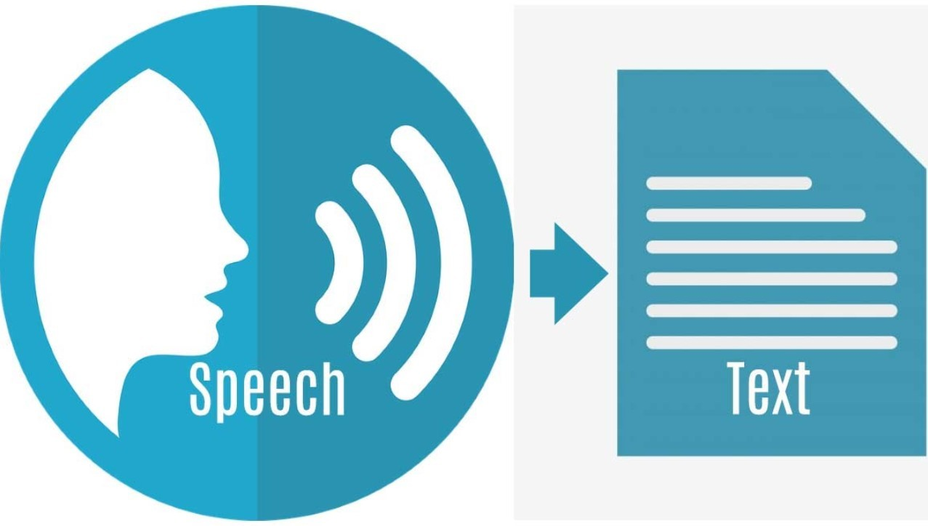
How It Works
Speech recognition system basically translates the spoken utterances to text. There are various real life examples of speech recognition system. For example- siri, alexa, which takes the speech as input and translates it into text.
The advantage of using a speech recognition system is that it overcomes the barrier of literacy. A speech recognition model can serve both literate and illiterate audience as well, since it focuses on spoken utterances.
We can also make an inventory of all the endangered languages around the world using a speech recognition system. While it looks pretty intriguing and not complex at all, a speech recognition system faces a lot of challenges in the making.

Slide 6
Challenges Faced By A Speech Recognition System
Style of speaking
Every individual person has a varied style of speaking, including accents as well. As we all know, we have different accents for speaking English too. There is American English, British English and so many other accents when it comes to speaking the most common language in the world.
Environment
Environment adds a lot of background noise to the system as well. An isolated room compared to an auditorium will have a lot a variability in background noises. Even echo can add a lot of noise in the system as well.
Speaker characteristics
An old person’s voice may not the be the same as that of an infant. The characteristics of a person’s speech depends on many factors including the harshness and clarity as well.
Language constraints
Some spoken utterances may not have a viable meaning when it comes to translation.

Slide 7
A little run back to history
Radio Rex – frequency prototype
Shoebox – Isolated Word Recognition
HARPY – Connected Speech
Deep Neural Network Based System

Slide 8
Packages available for speech recognition in python
SpeechRecognition
apiai
Google_speech_cloud
assemblyai
Pocketsphinx
Watson_developer_cloud
wit

Slide 9
SpeechRecognition Package
The package has a Recognizer class which is basically where the magic happens. It is basically a class which is used to recognize the speech. Following are seven methods which can read various audio sources using different APIs.
recognize_bing( )
recognize_google( )
recognize_google_cloud( )
recognize_houndify( )
recognize_ibm( )
recognize_wit( )
recognize_sphinx( )

Slide 10
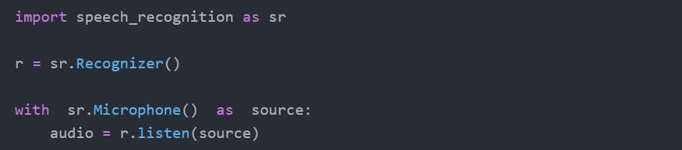
Taking Input From Microphones
To use the microphones, we will have to install pyaudio module as well. We use the microphone class to get the input speech from the microphone instead of any other input method like an audio file.
For most of the projects, we can use the default microphones. But if we do not wish to use the default microphone, we can get the list of microphone names using the list_microphone_names method.
To capture the input from the microphone we use the listen method.

Slide 11
Use Case
We will make a program using the speechrecognition module in python to recognize speech and execute the following:
convert the speech to text
open a URL using webbrowser module
pass a query using speech recognition to make a search in the url

Slide 12
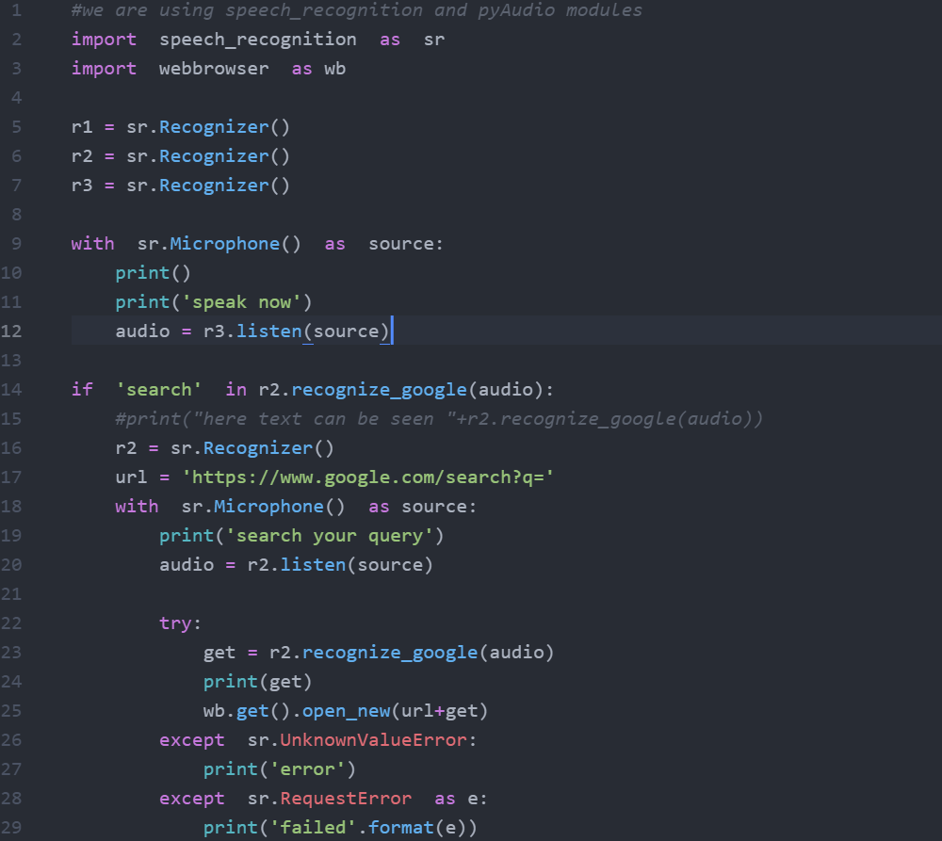

Slide 13
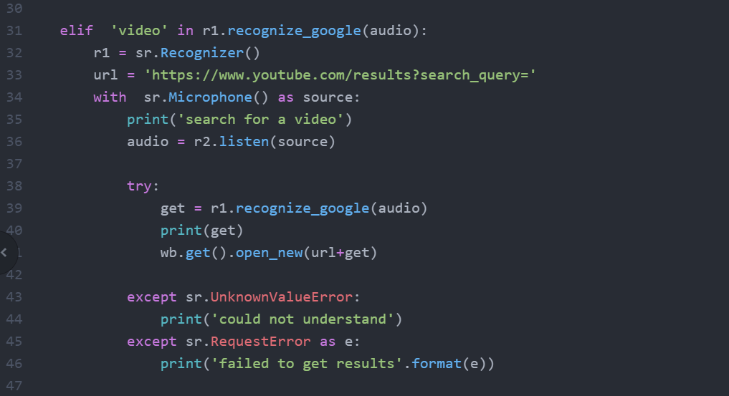

Slide 14
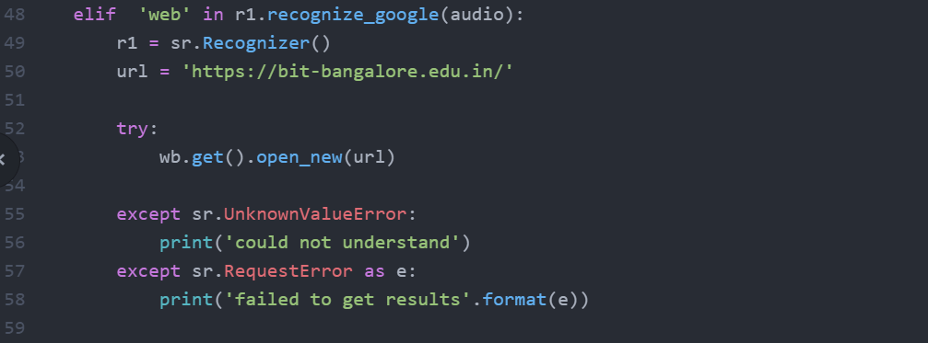

Slide 15
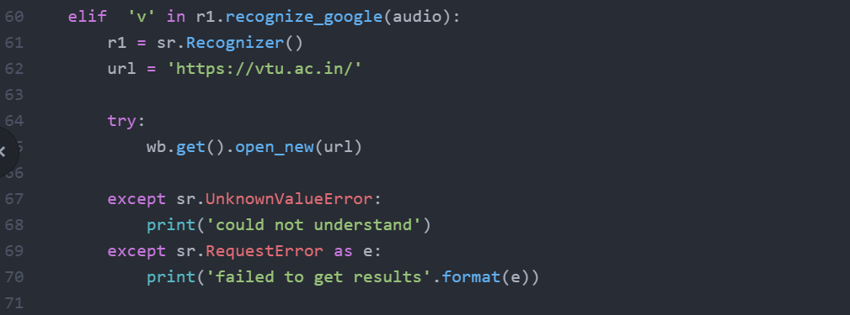

Slide 16
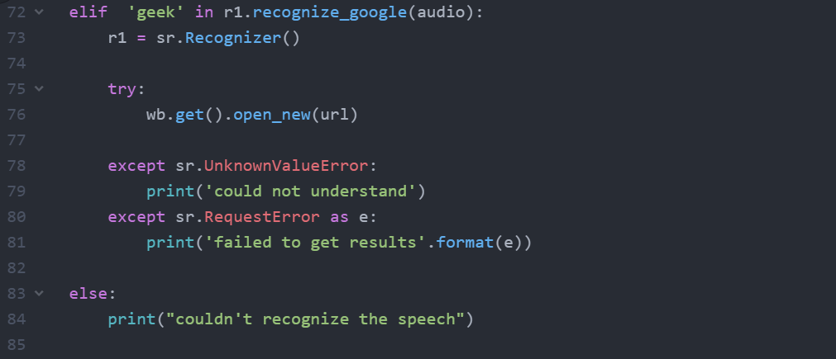

Slide 17
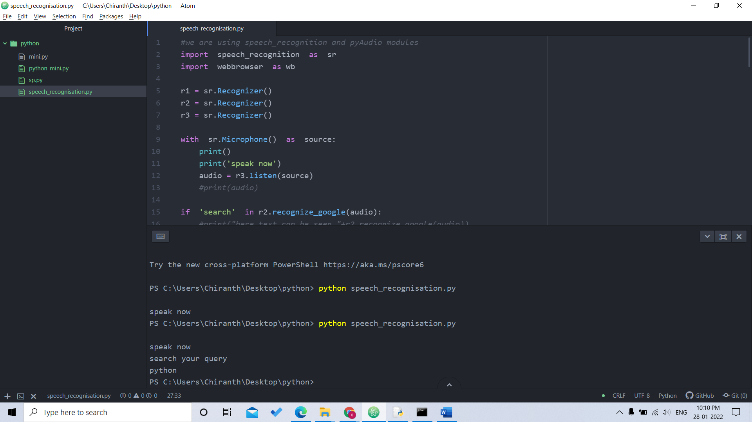
OUTPUT

Slide 18

OUTPUT

Slide 19
Applications
1.In the workplace
Speech recognition technology in the workplace has evolved into incorporating simple tasks to increase efficiency, as well as beyond tasks that have traditionally needed humans, to be performed.
2.In Banking
The aim of the banking and financial industry is for speech recognition to reduce friction for the customer. Voice-activated banking could largely reduce the need for human customer service, and lower employee costs. A personalised banking assistant could in return boost customer satisfaction and loyalty
3.In marketing
Voice-search has the potential to add a new dimension to the way marketers reach their consumers. With the change in how people are going to be interacting with their devices, marketers should look for developing trends in user data and behaviour

Slide 20
Applications
4.In Healthcare
In an environment where seconds are crucial and sterile operating conditions are a priority, hands-free, immediate access to information can have a significantly positive impact on patient safety and medical efficiency.
5.In language learning
One of the most transformative applications of speech recognition technology from a human perspective is its ability to remove language barriers and cultural boundaries in aspects of social life and in the workplace.

Slide 21
Conclusion
Speech recognition technology allows computers to take spoken audio, interpret it and generate text from it
The Future scope of the system is very good.
This Technology is Beneficial for public and private sectors of the business community.
This technology is easily use by children and adults.

Slide 22
THANK YOU

